Slide 1
Election Selection
brough to you the House of Cards

Slide 2


Slide 3
Our inspiration
The relationship between demographic factors and election results is complex and multifaceted. While population size can be an important factor in determining election outcomes, it is not the only factor that matters. Other demographic factors such as income, age, and poverty rate can also play a role in shaping voter preferences. For example, areas with higher household income may tend to vote for candidates who advocate for policies that benefit the wealthy, while areas with lower household income may be more likely to support candidates who prioritize policies that address economic inequality. Similarly, areas with a higher average age may be more likely to vote for candidates who focus on issues such as retirement benefits and healthcare for seniors, while areas with a younger population may be more concerned with issues such as education and job opportunities. Overall, understanding the relationship between demographic factors and election results can be an important tool for election campaign managers in developing strategies to target specific voter groups and appeal to their priorities and concerns.
Notes:
Add a flag

Slide 4
Our data
API
(census.gov)
Demographic information by year, state and county:
Population size
Household income
Median Age
Per Capita Income
Poverty Rate
Csv file
Election winners by year, state and county
Database
Mongo database
Over 9k rows and 10 columns
Wrangling
Merge sources
Filter data
Remove duplicates and null records
Evaluate results
Publish

Slide 5
Experiments
Our data comprises of demographic features and a categorical result: the winner!
Using supervised machine learning we experimented with various models in our analysis to select the best one.
We looked at models that pertain well for numerical predictions, as well as models that use classification methods for prediction.
Random Forest
SVM
Logistical Regression
Neural Network
KNN
Notes:
Huntley

Slide 6
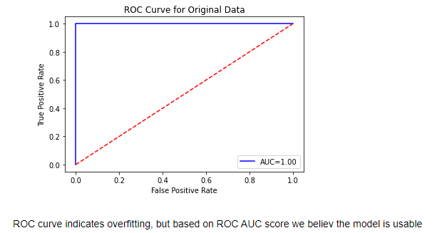
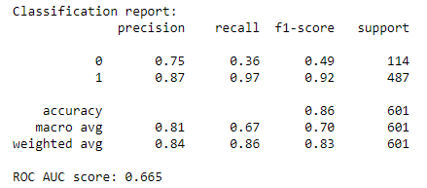
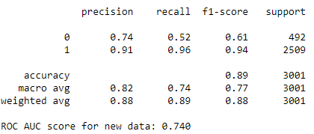
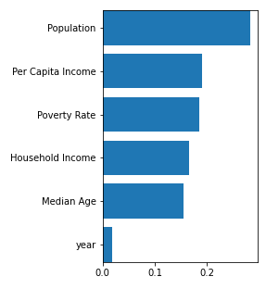
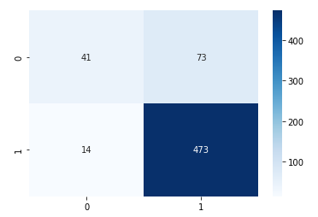
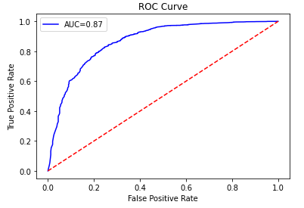
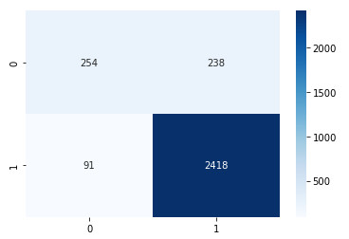
Random Forest
Training the model
The results
Notes:
Based on the results of the original data, the model had an accuracy of 0.86 with a precision of 0.87 for predicting winners, but had a low recall of 0.36 for predicting losers. The ROC AUC score was 0.665, which indicates the model had only slightly better performance than random guessing.
When the model was tested on new data (2020 election results), it had an accuracy of 0.89 with a precision of 0.91 for predicting winners and a recall of 0.52 for predicting losers. The ROC AUC score was 0.74, which indicates the model had a moderate performance in predicting the winners.
Our 2020 data shows the winner as republican, and the model predicted that well, however in reality democrats won. We may need to check the source of our winner database.

Slide 7
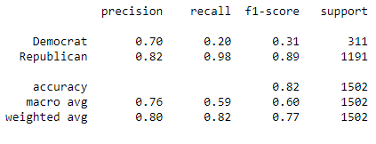
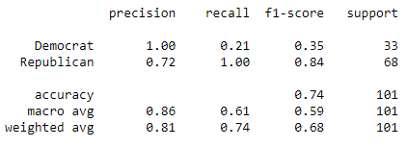
SVM
Training the model
The results
this
this

Slide 8
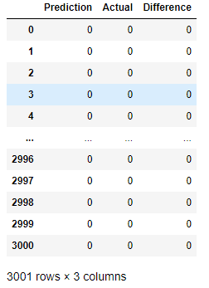
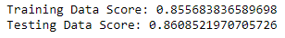
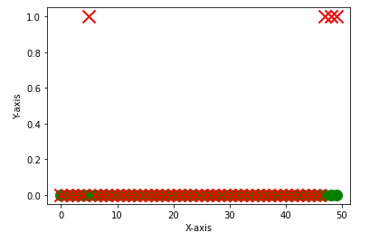
Logistical Regression
Training the model
The results
this
this

Slide 9
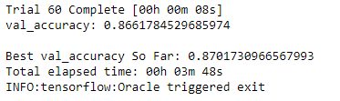
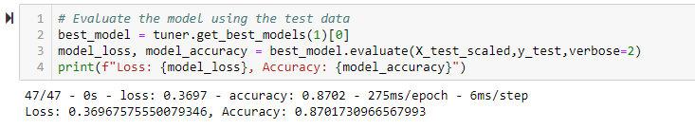
Neural Network
Training the model
The results
this
this

Slide 10
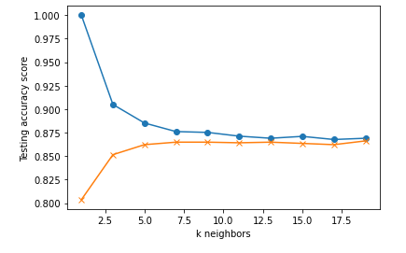
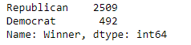
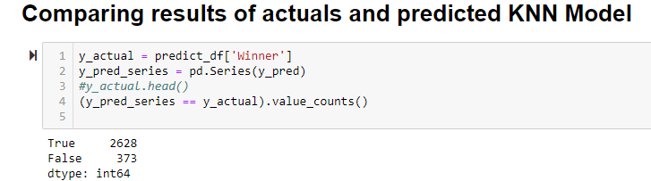
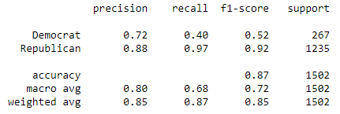
KNN
Training the model
The results
this
this

Slide 11
Comparing the results

Slide 12
Our recommendation
Random Forest?
Notes:
Funny story – when we were testing the models on 2020 data, we all were seeing that the predicted winner was republican! Initially we thought the models were broken and we needed to go back to work. Turns out, the election winners data we found may not have been from the most reputable source… Our lesson learned in this project is that any models is only as good as the data we feed it

Slide 13
Thank you!
And don’t forget to vote

Slide 14
Title and Content Layout with Table
First bullet point here
Second bullet point here
Third bullet point here
Class | Group 1 | Group 2
Class 1 | 82 | 95
Class 2 | 76 | 88
Class 3 | 84 | 90

Slide 16
Add a Slide Title - 5

